Slide 1
Question 1
SELECT THE SINGLE BEST ANSWER
One of the characteristics that differentiates all haploid cells from all diploid cells is that
haploid cells have half as many chromosomes than diploid cells.
haploid cells have one full set of chromosomes while diploid cells have two.
haploid cells’ chromosomes have a different structure/shape from diploid cells’ chromosomes.
d) haploid cells have half the amount of DNA as diploid cells.

Slide 2
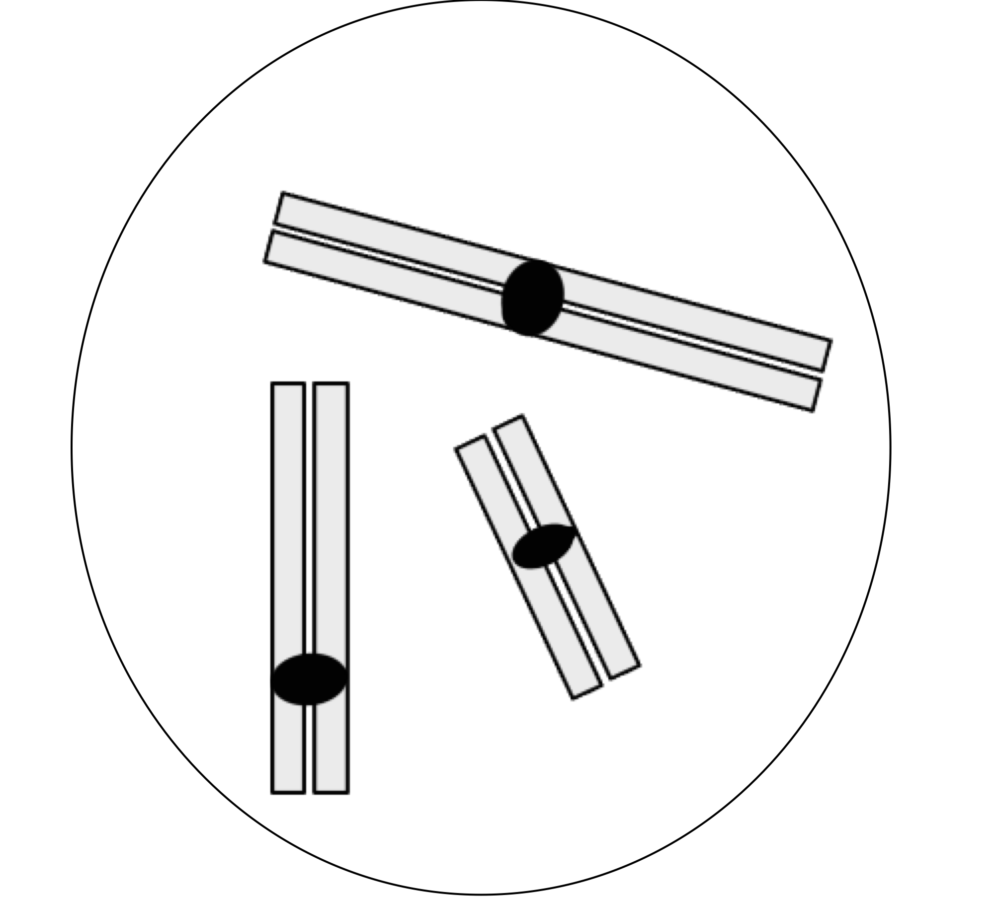
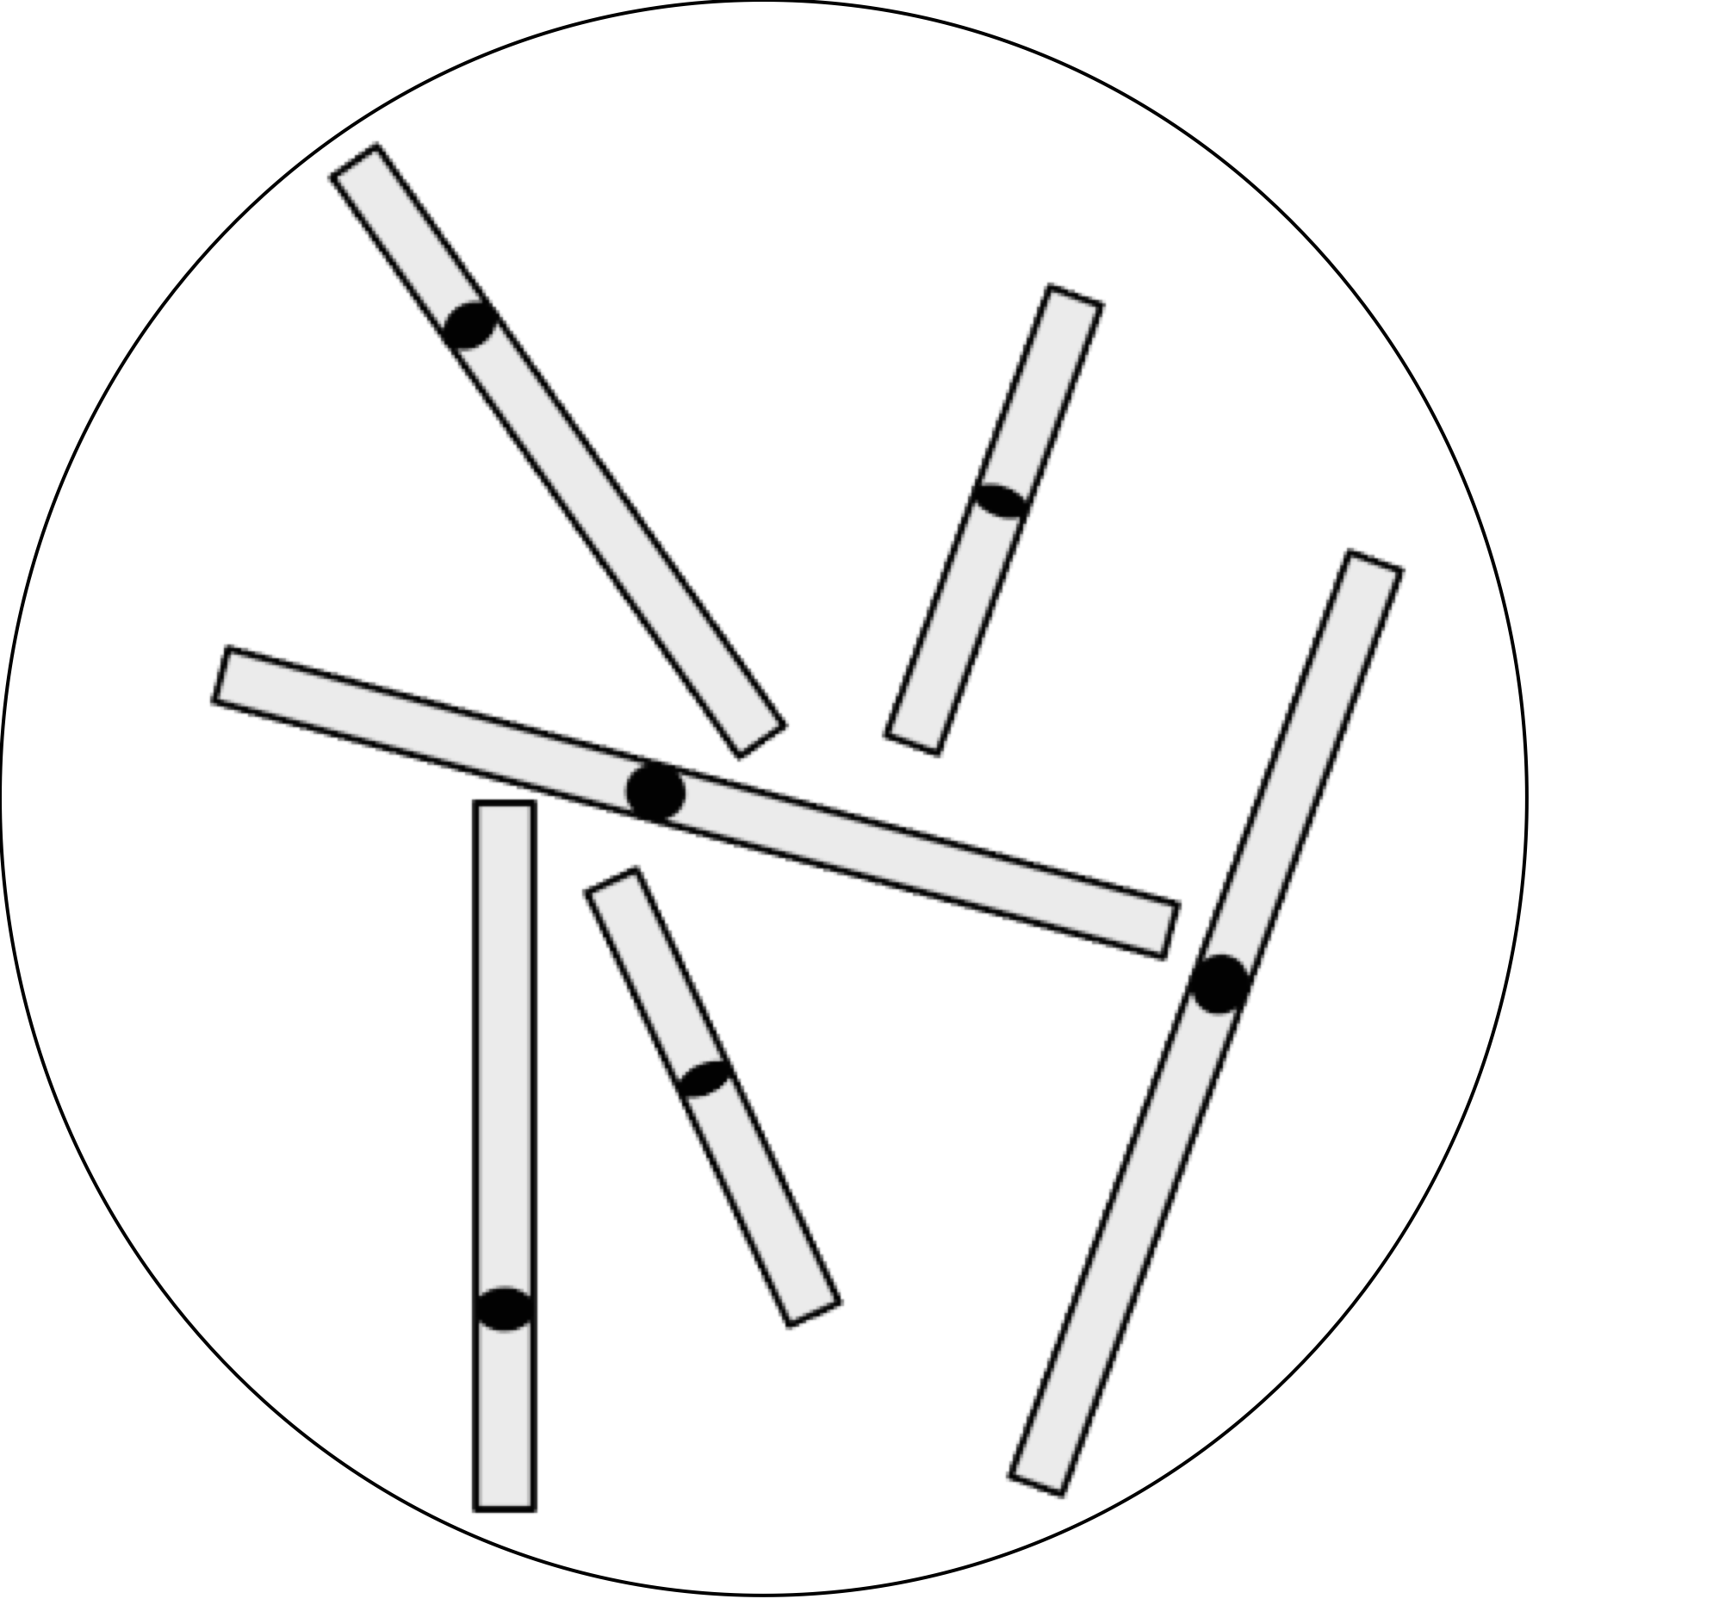
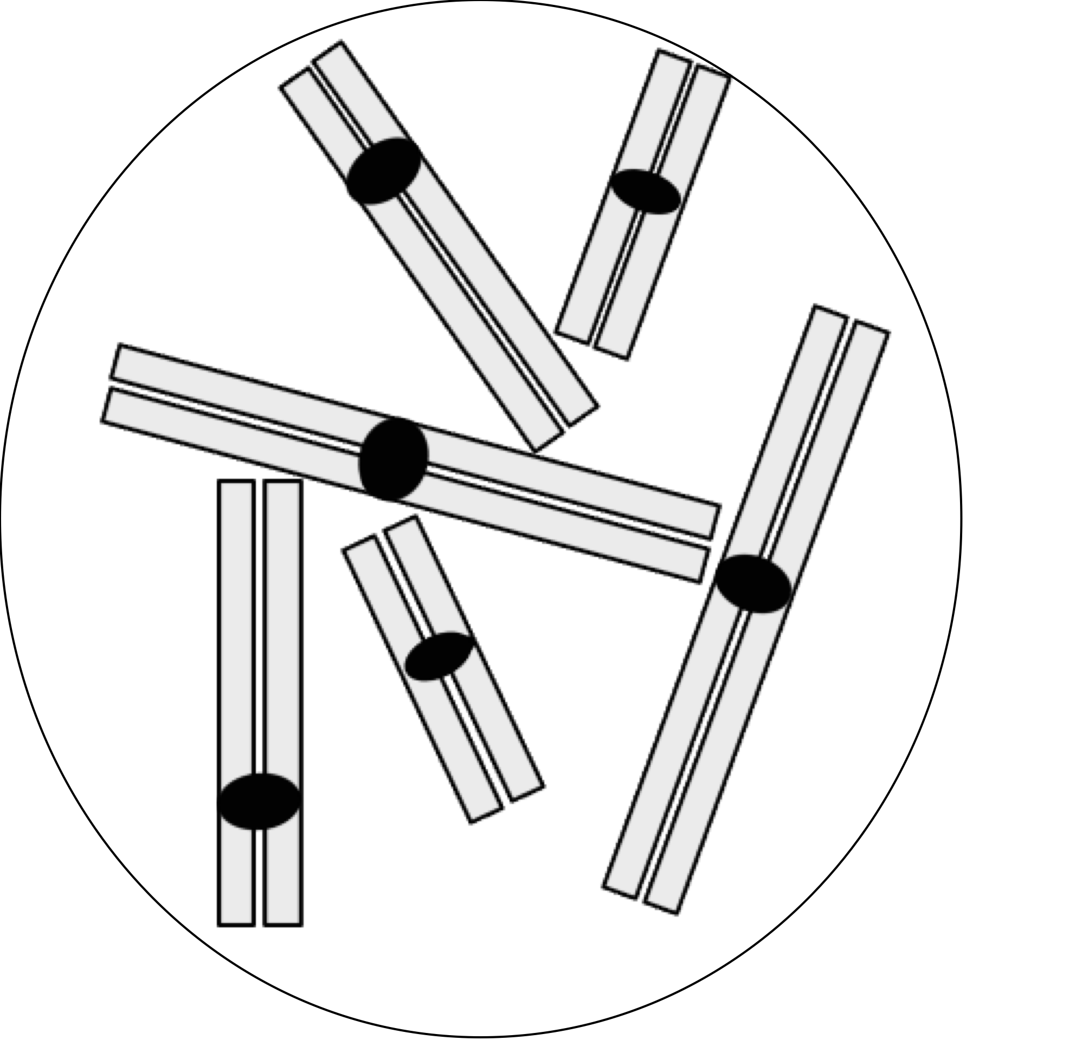
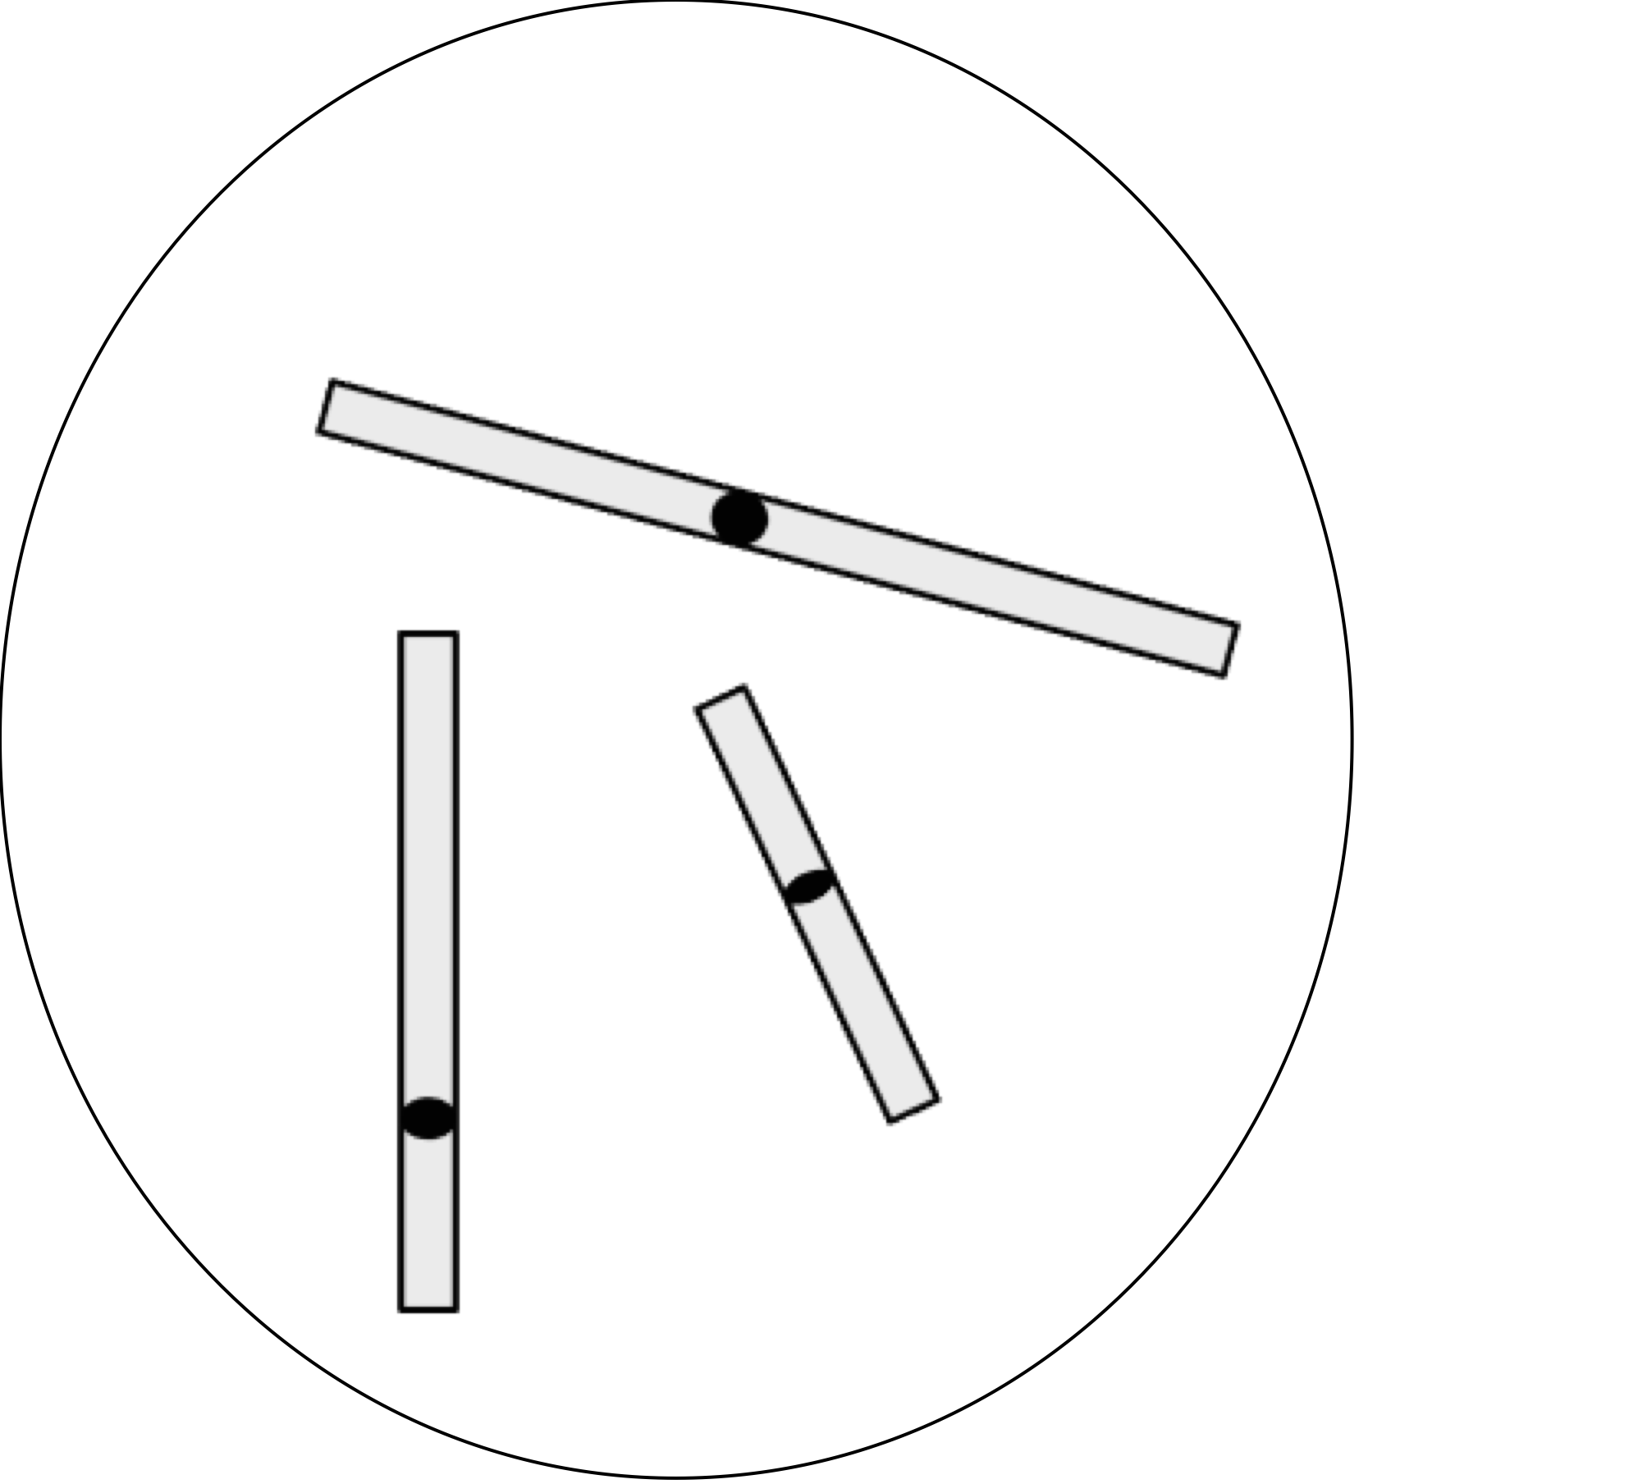
Question 2
SELECT THE SINGLE BEST ANSWER
A certain cell is diploid and has a total of six chromosomes. If we pretend that its chromosomes remain condensed throughout the cell cycle, which of the diagrams below correctly represents the chromosomes of this cell before DNA replication?
a) b) c) d)

Slide 3
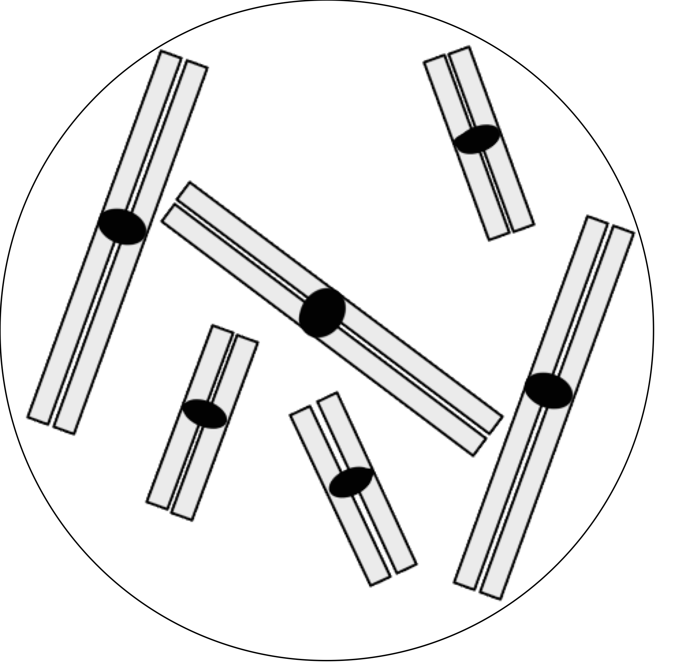
Question 3
SELECT THE SINGLE BEST ANSWER
If we pretend that chromosomes remain condensed throughout the cell cycle, what notation best describes the cell pictured below?
a) n=2 (haploid with two chromosomes)
b) n=3 (haploid with three chromosomes)
c) 2n=6 (diploid with six chromosomes)
d) 3n=6 (triploid with six chromosomes)

Slide 4
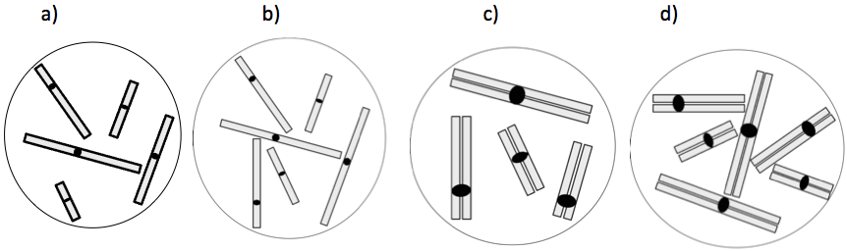
Question 4
SELECT ALL THE ANSWERS THAT APPLY
One or more of the cells represented below are haploid. Which one is it/which ones are they?

Slide 5
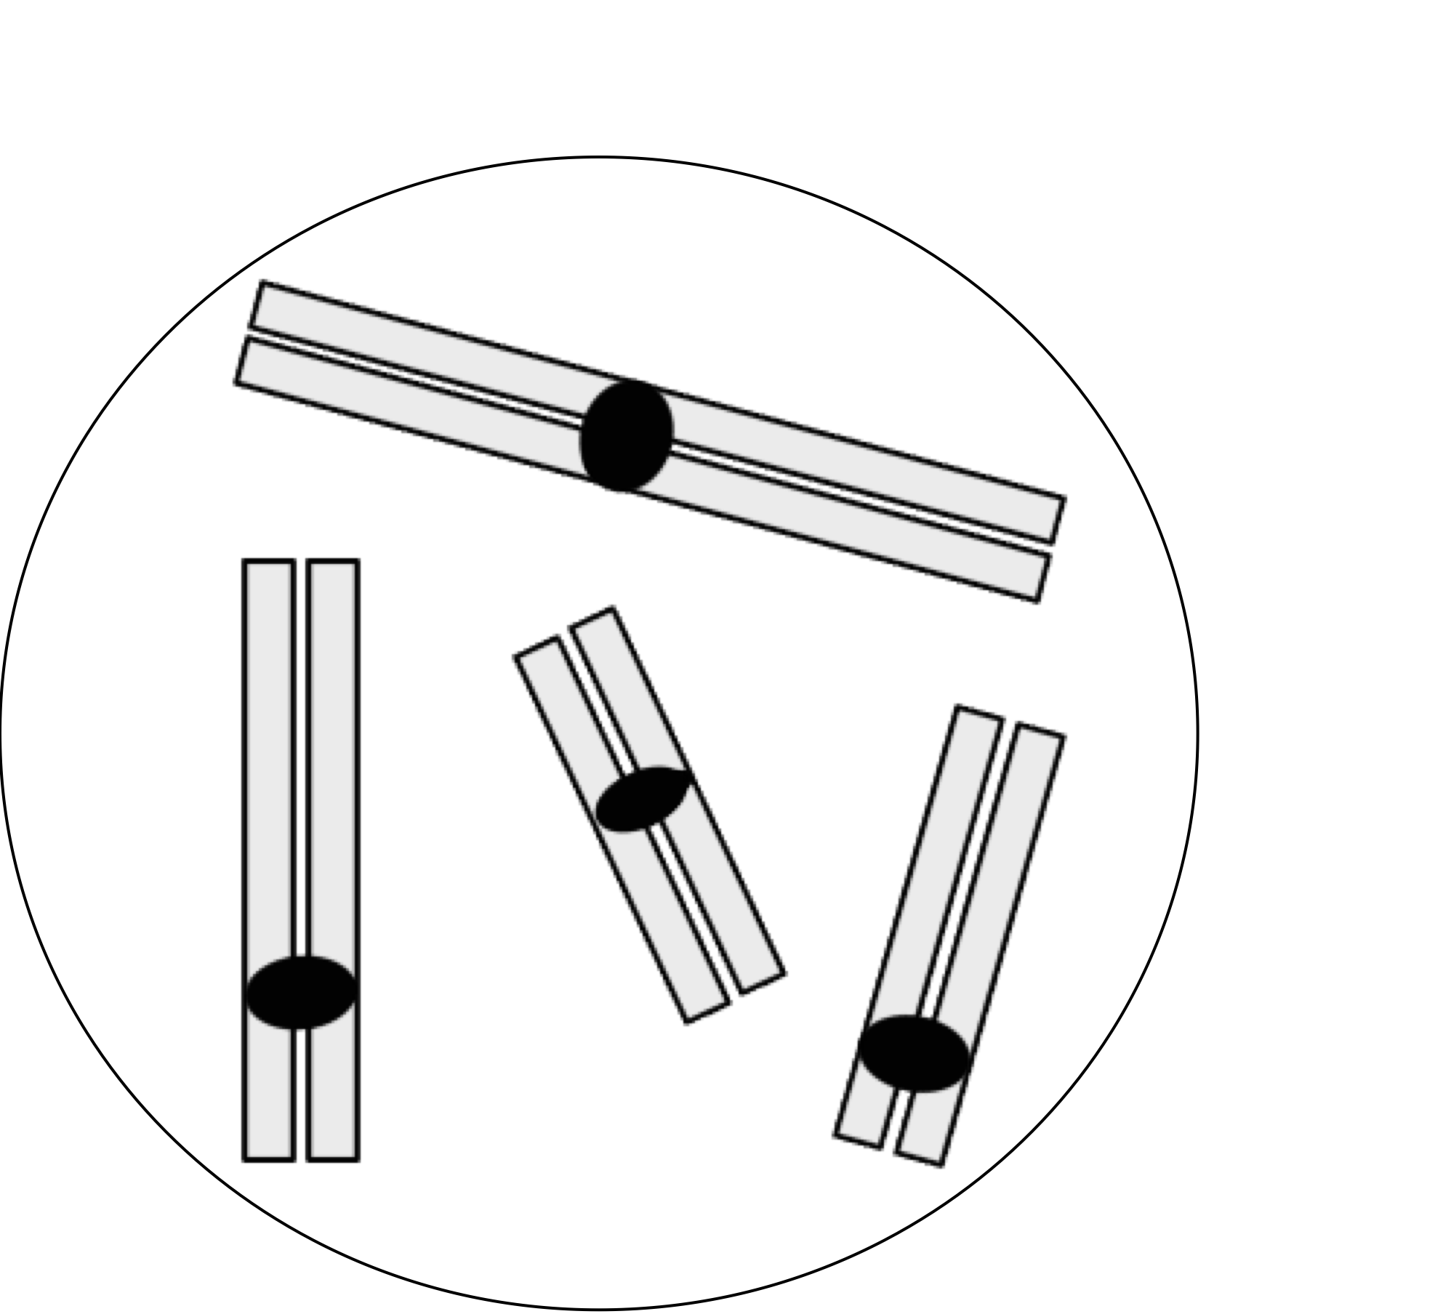
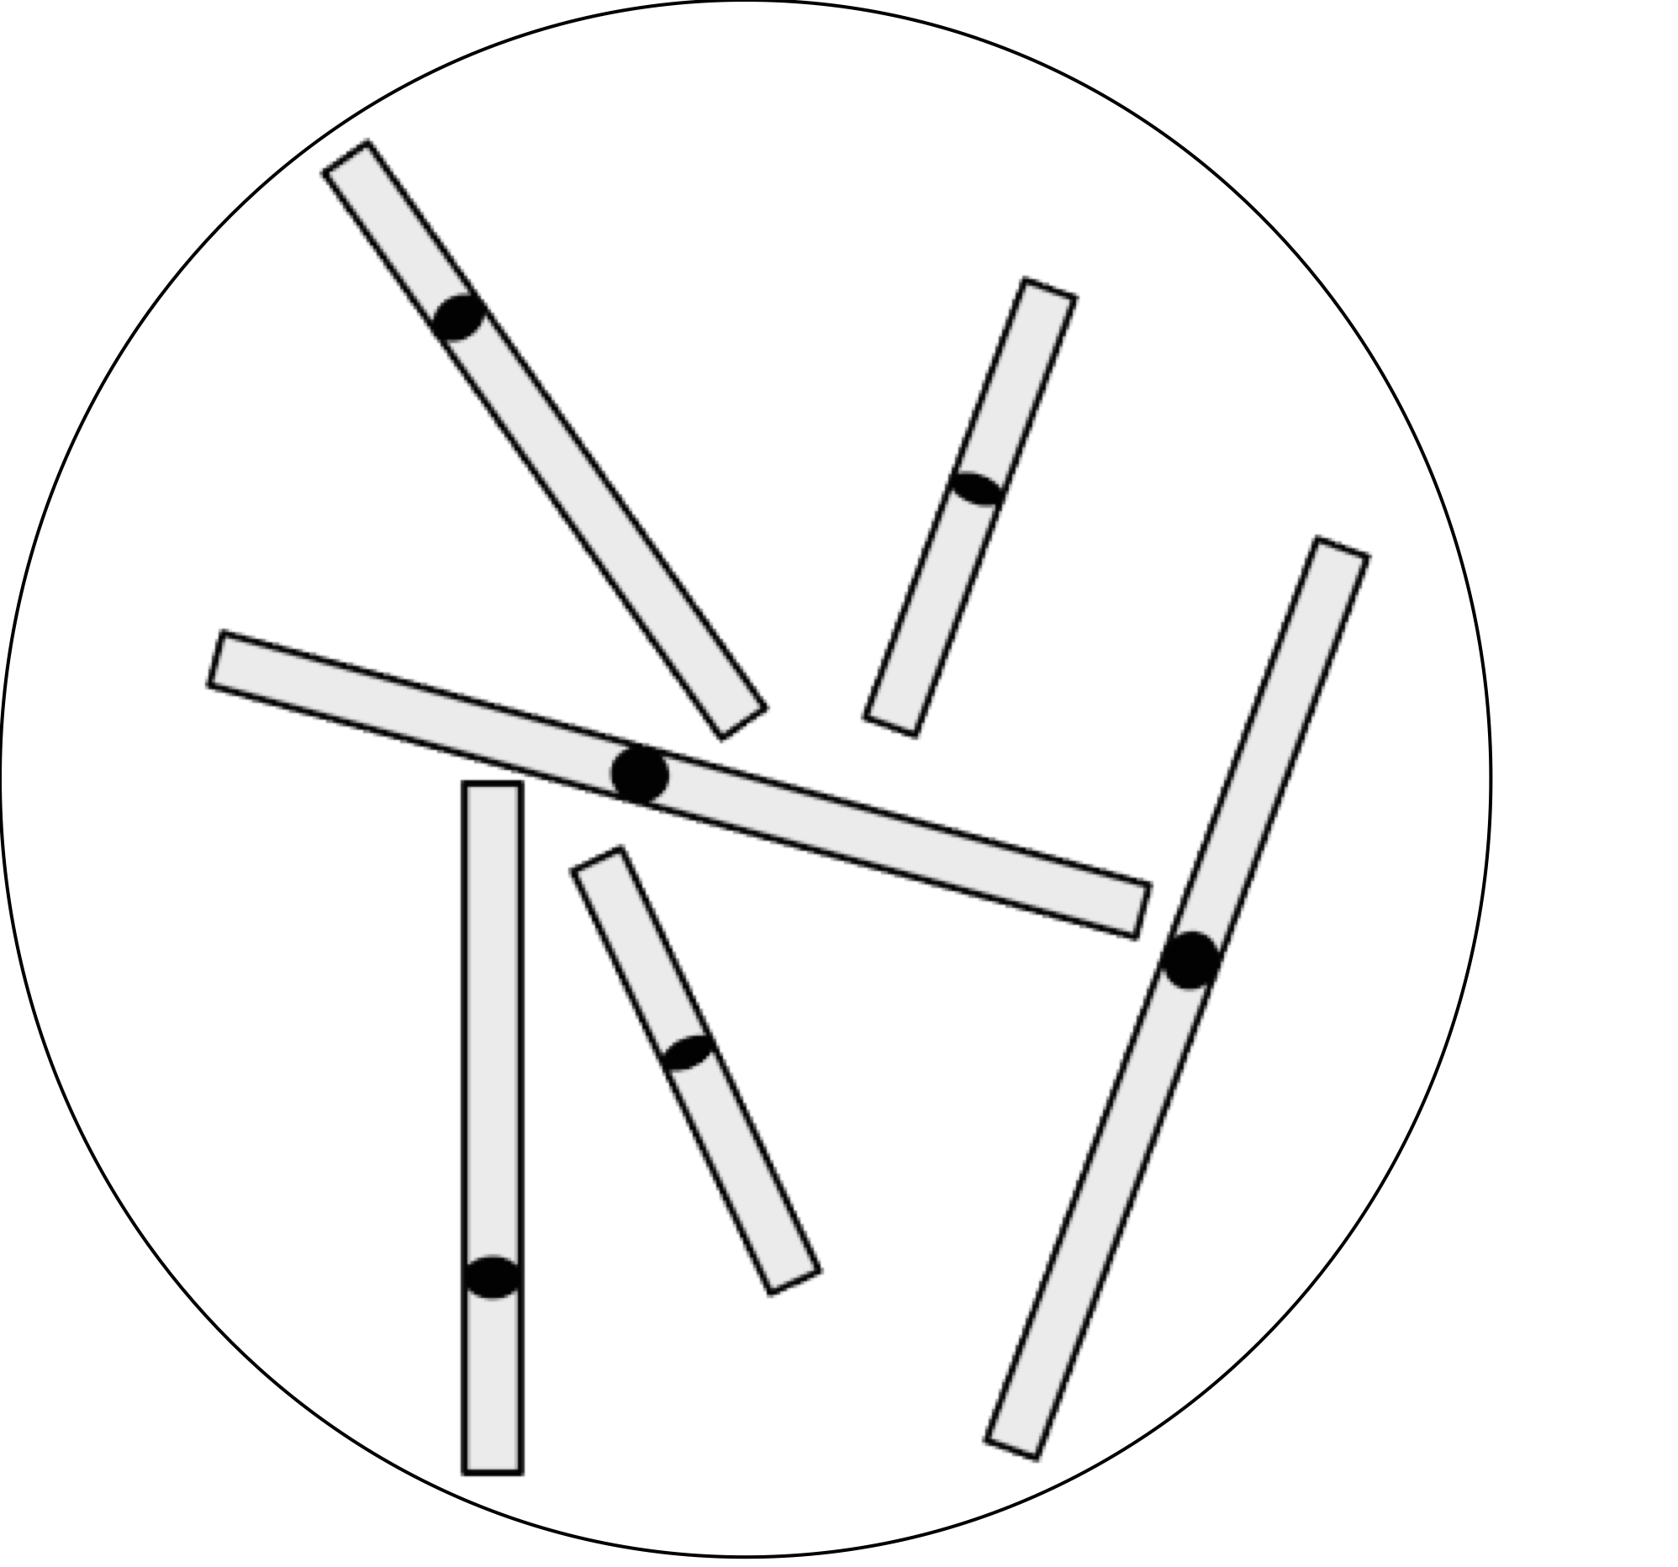
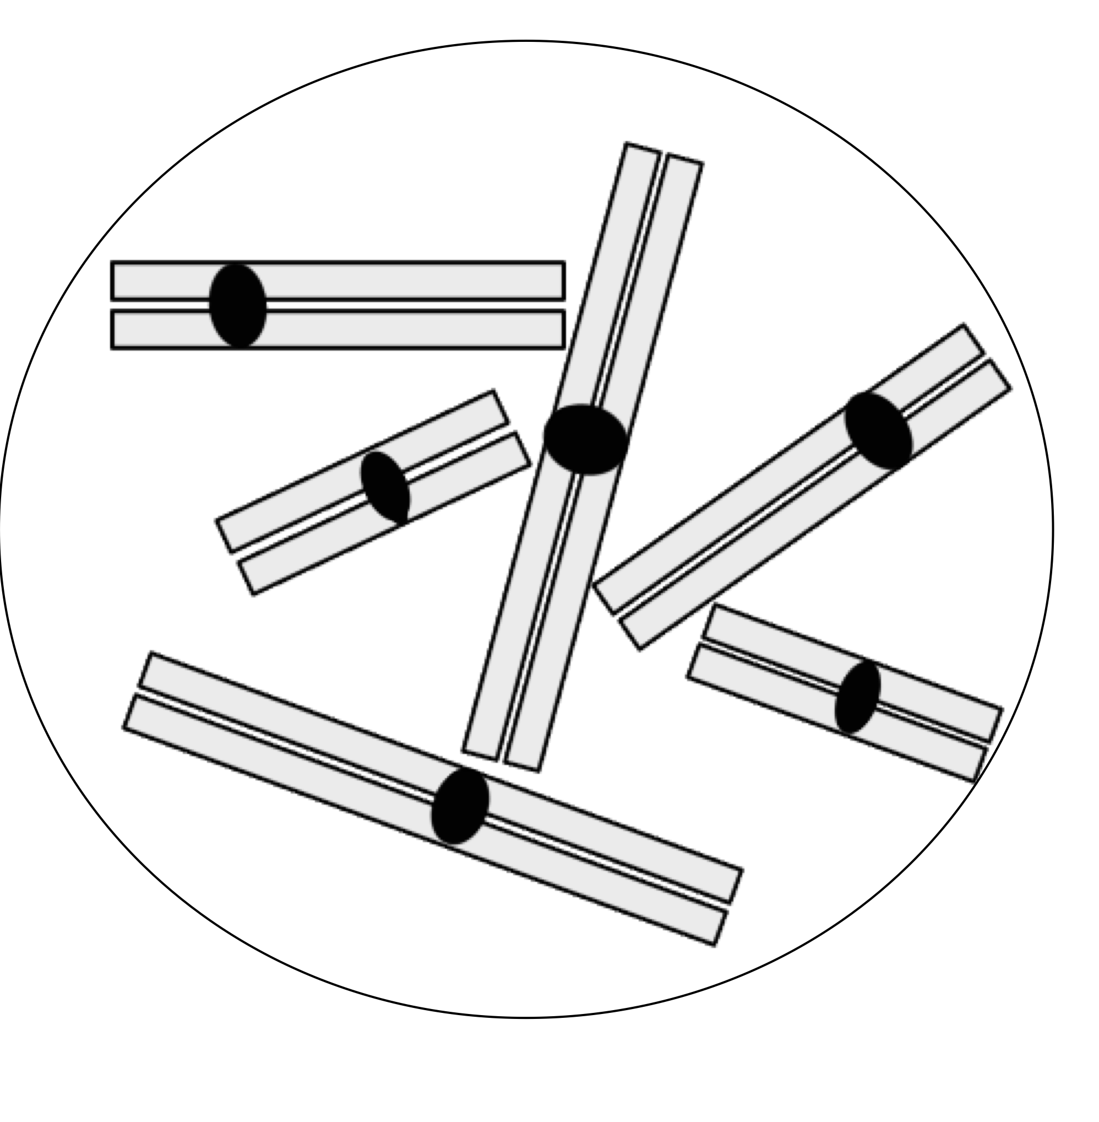
Question 5
SELECT ALL THE ANSWERS THAT APPLY
One or more of the cells represented below are diploid. Which one is it/which ones are they?
a) b) c) d)

Slide 6
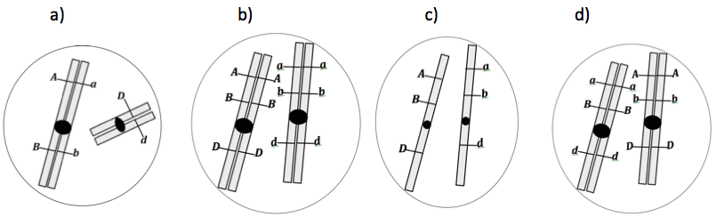
Question 6
SELECT ALL THE ANSWERS THAT APPLY
A diploid plant of interest has a total of two chromosomes per (somatic) cell, and its genotype is AaBbDd. If we pretend that chromosomes remain condensed throughout the cell cycle, which of the diagrams below could represent a cell that contains the two chromosomes of this plant?

Slide 7

Question 7
SELECT ALL THE ANSWERS THAT APPLY
Sometimes chromosomes are represented like X’s or like in the picture on the right.
This picture represents a
a) chromosome composed of two sister chromatids.
b) chromosome that has undergone DNA replication.
c) chromosome in its diploid state.
d) pair of homologous chromosomes.

Slide 8
Question 8
SELECT ALL THE ANSWERS THAT APPLY
In a eukaryotic cell, DNA replication results in an increase in the
a) amount of DNA in that cell.
b) number of chromosomes in that cell.
c) number of DNA molecules in that cell.
d) ploidy of that cell (e.g. from 2n to 4n).

Slide 9
Question 9
SELECT ALL THE ANSWERS THAT APPLY
The object represented below is composed of
a) four single-stranded DNA molecules.
b) one double stranded DNA molecule.
c) two double-stranded DNA molecules.
d) two single-stranded DNA molecules.

Slide 10
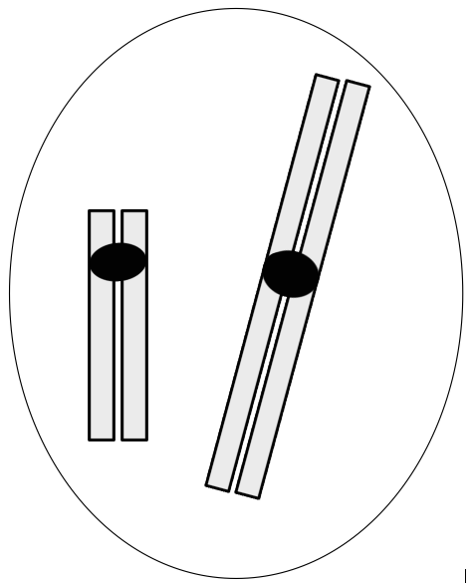
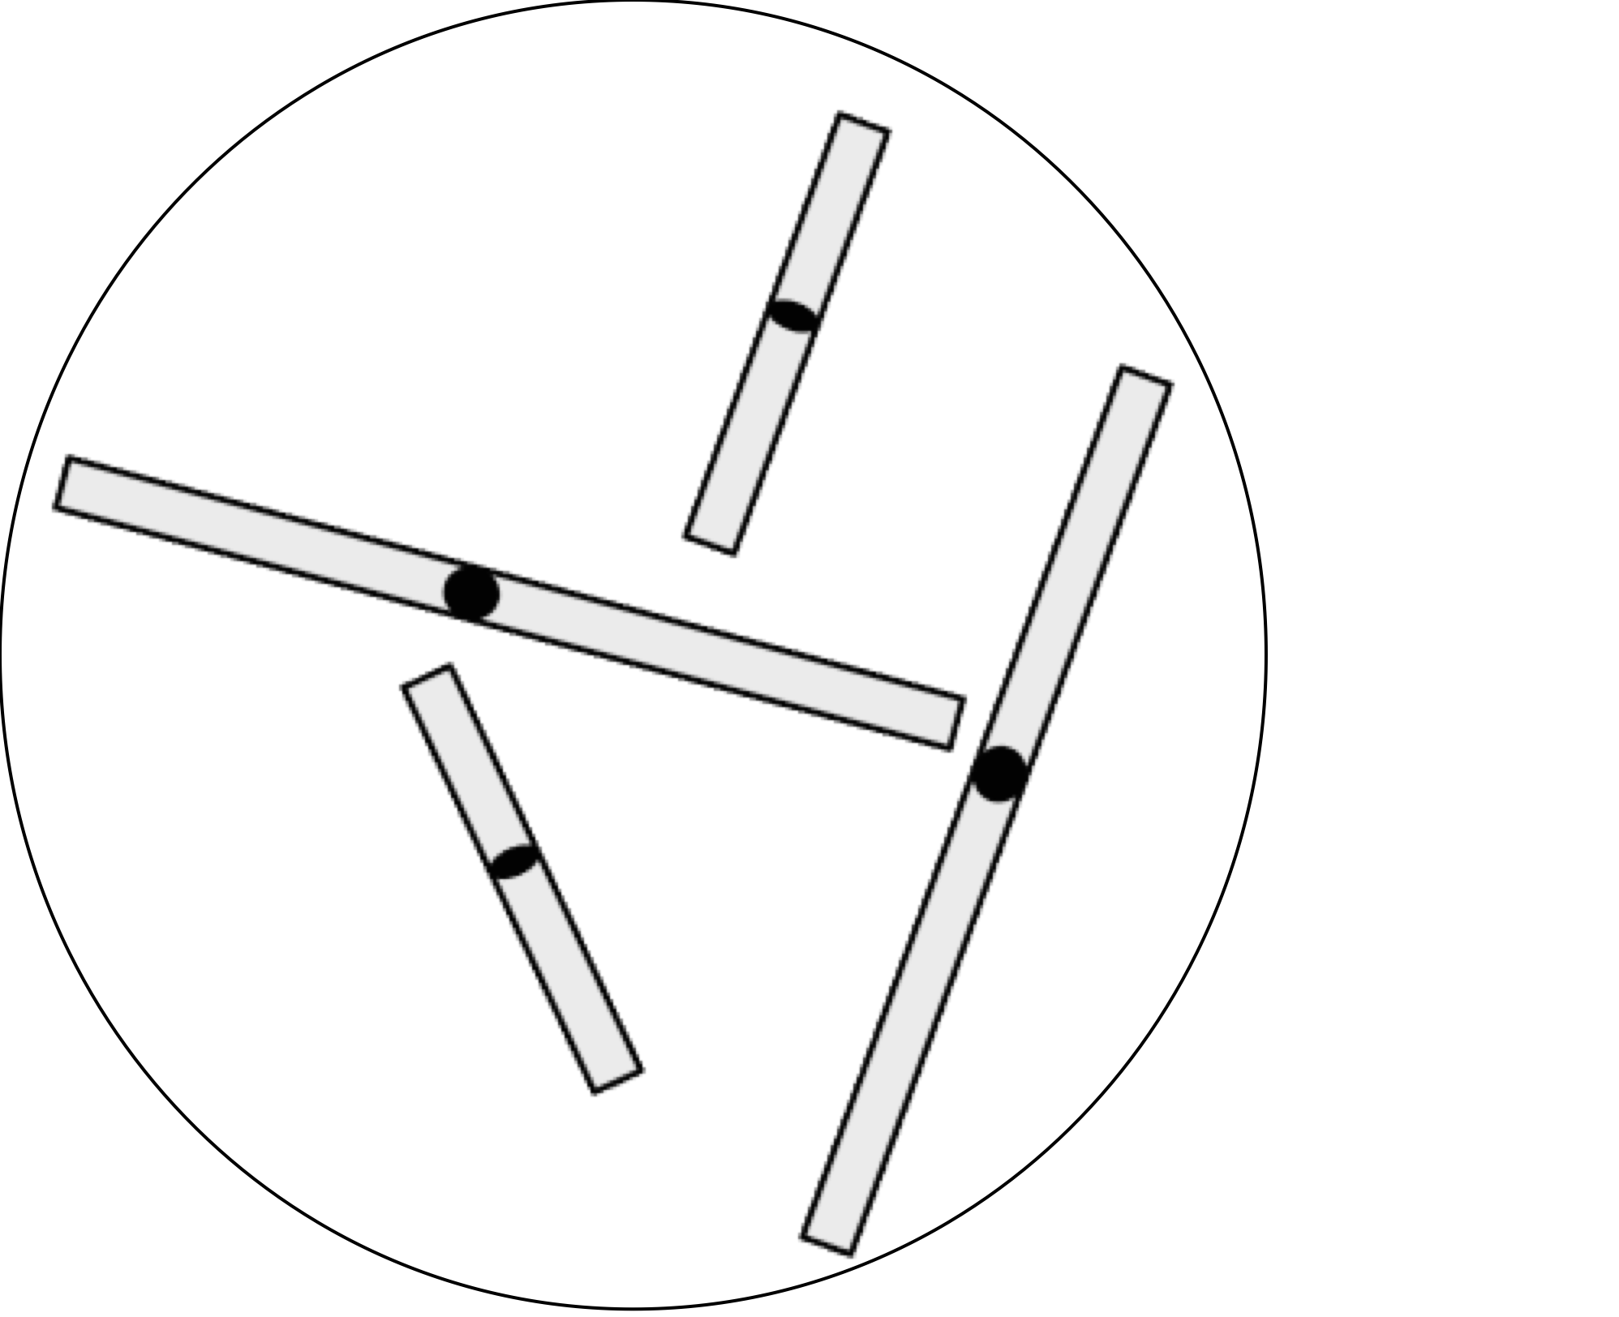
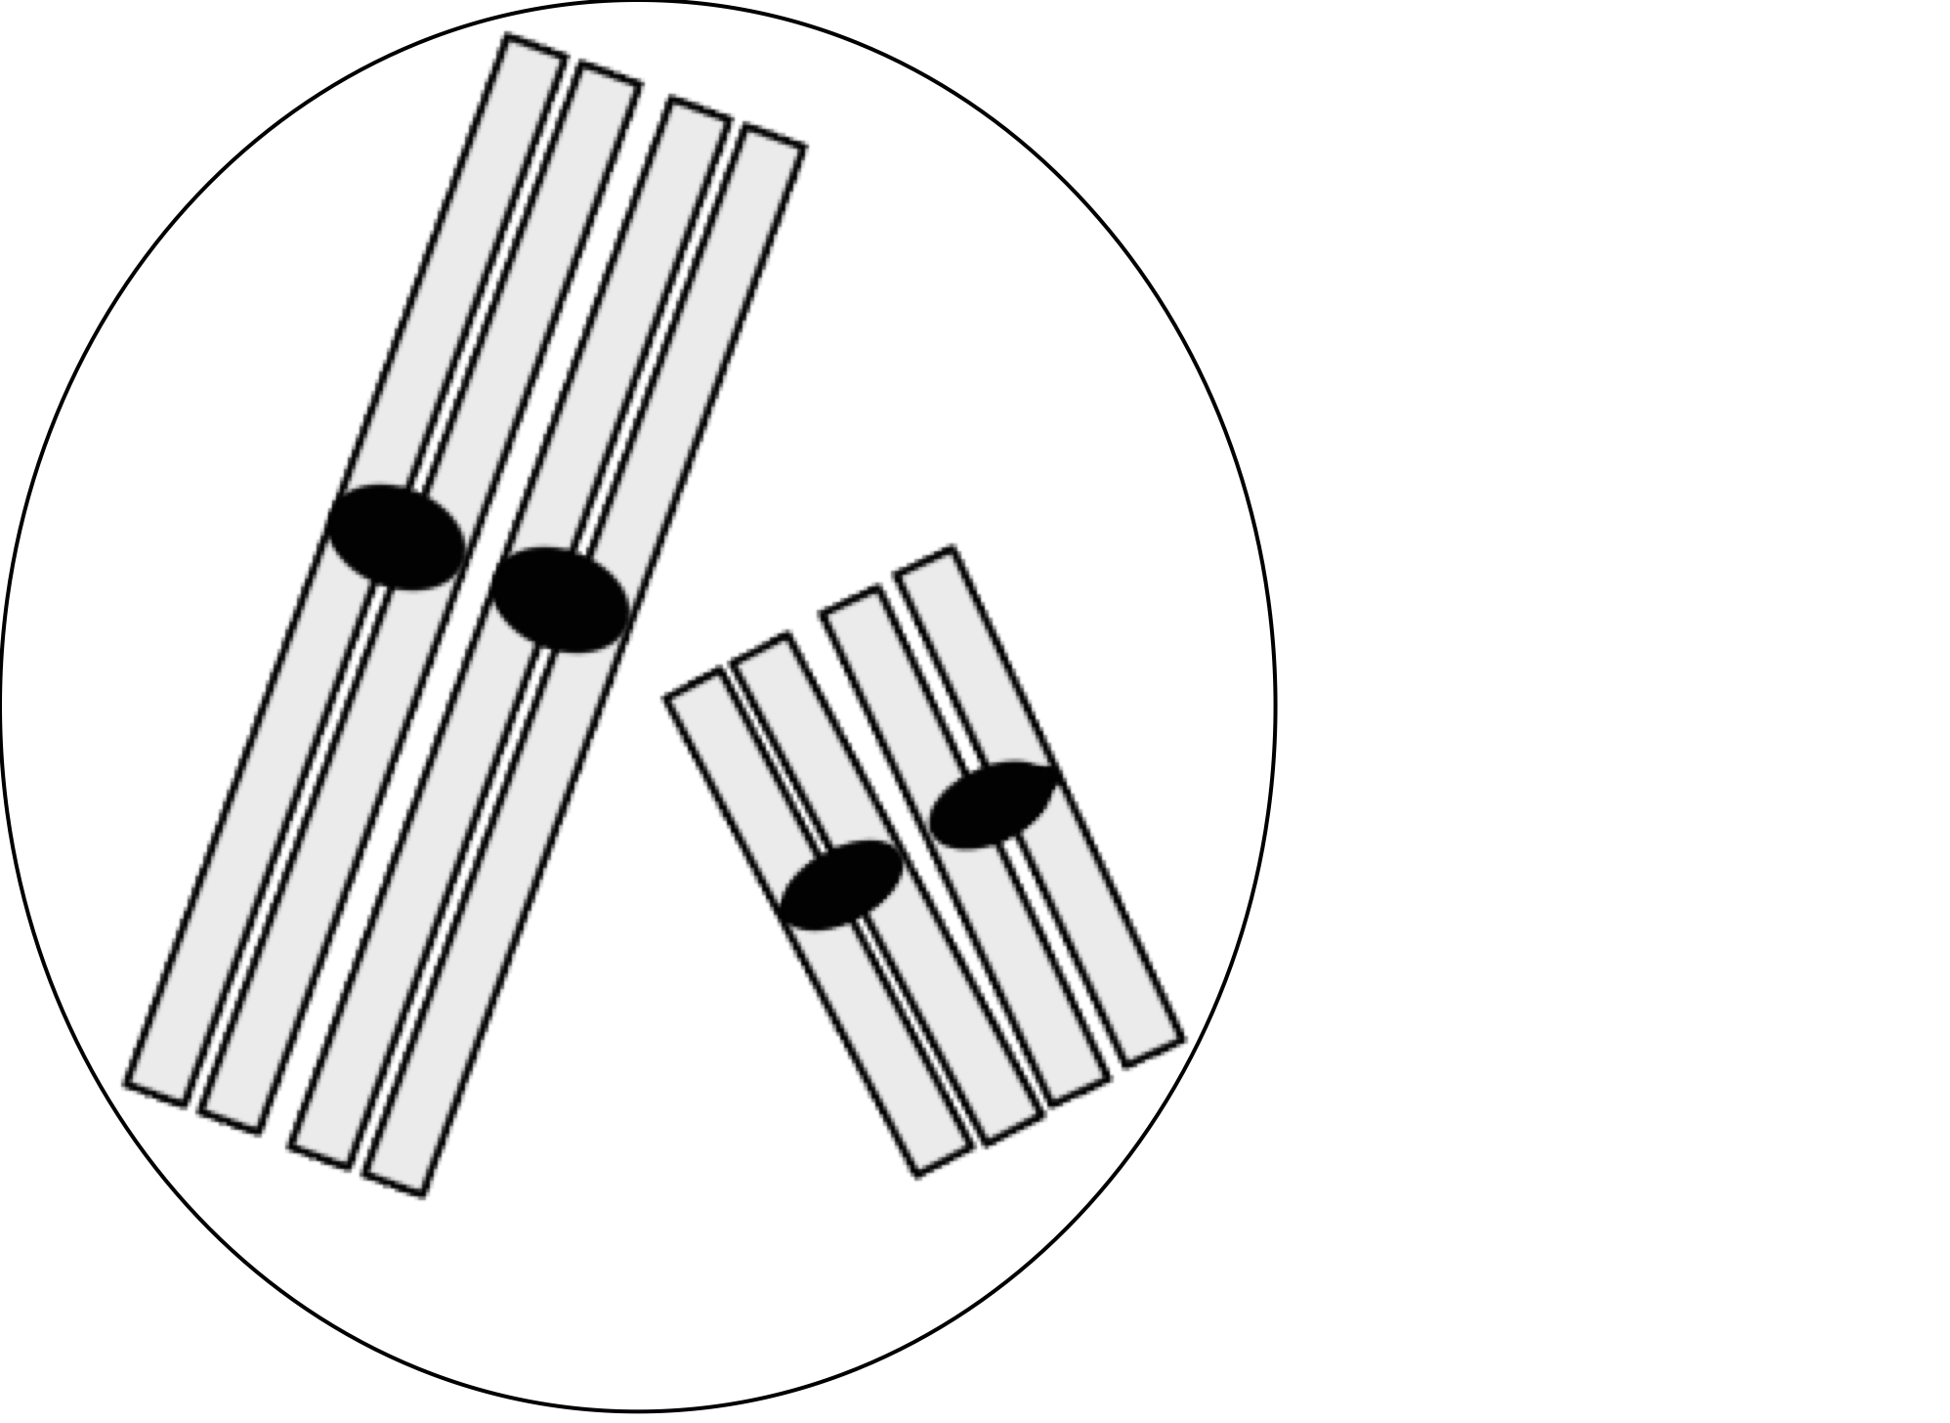

Question 10
SELECT ALL THE ANSWERS THAT APPLY
Which of the nuclei represented below have the same number of double-stranded DNA molecules as the one represented on the right?
a) b) c)

Slide 11
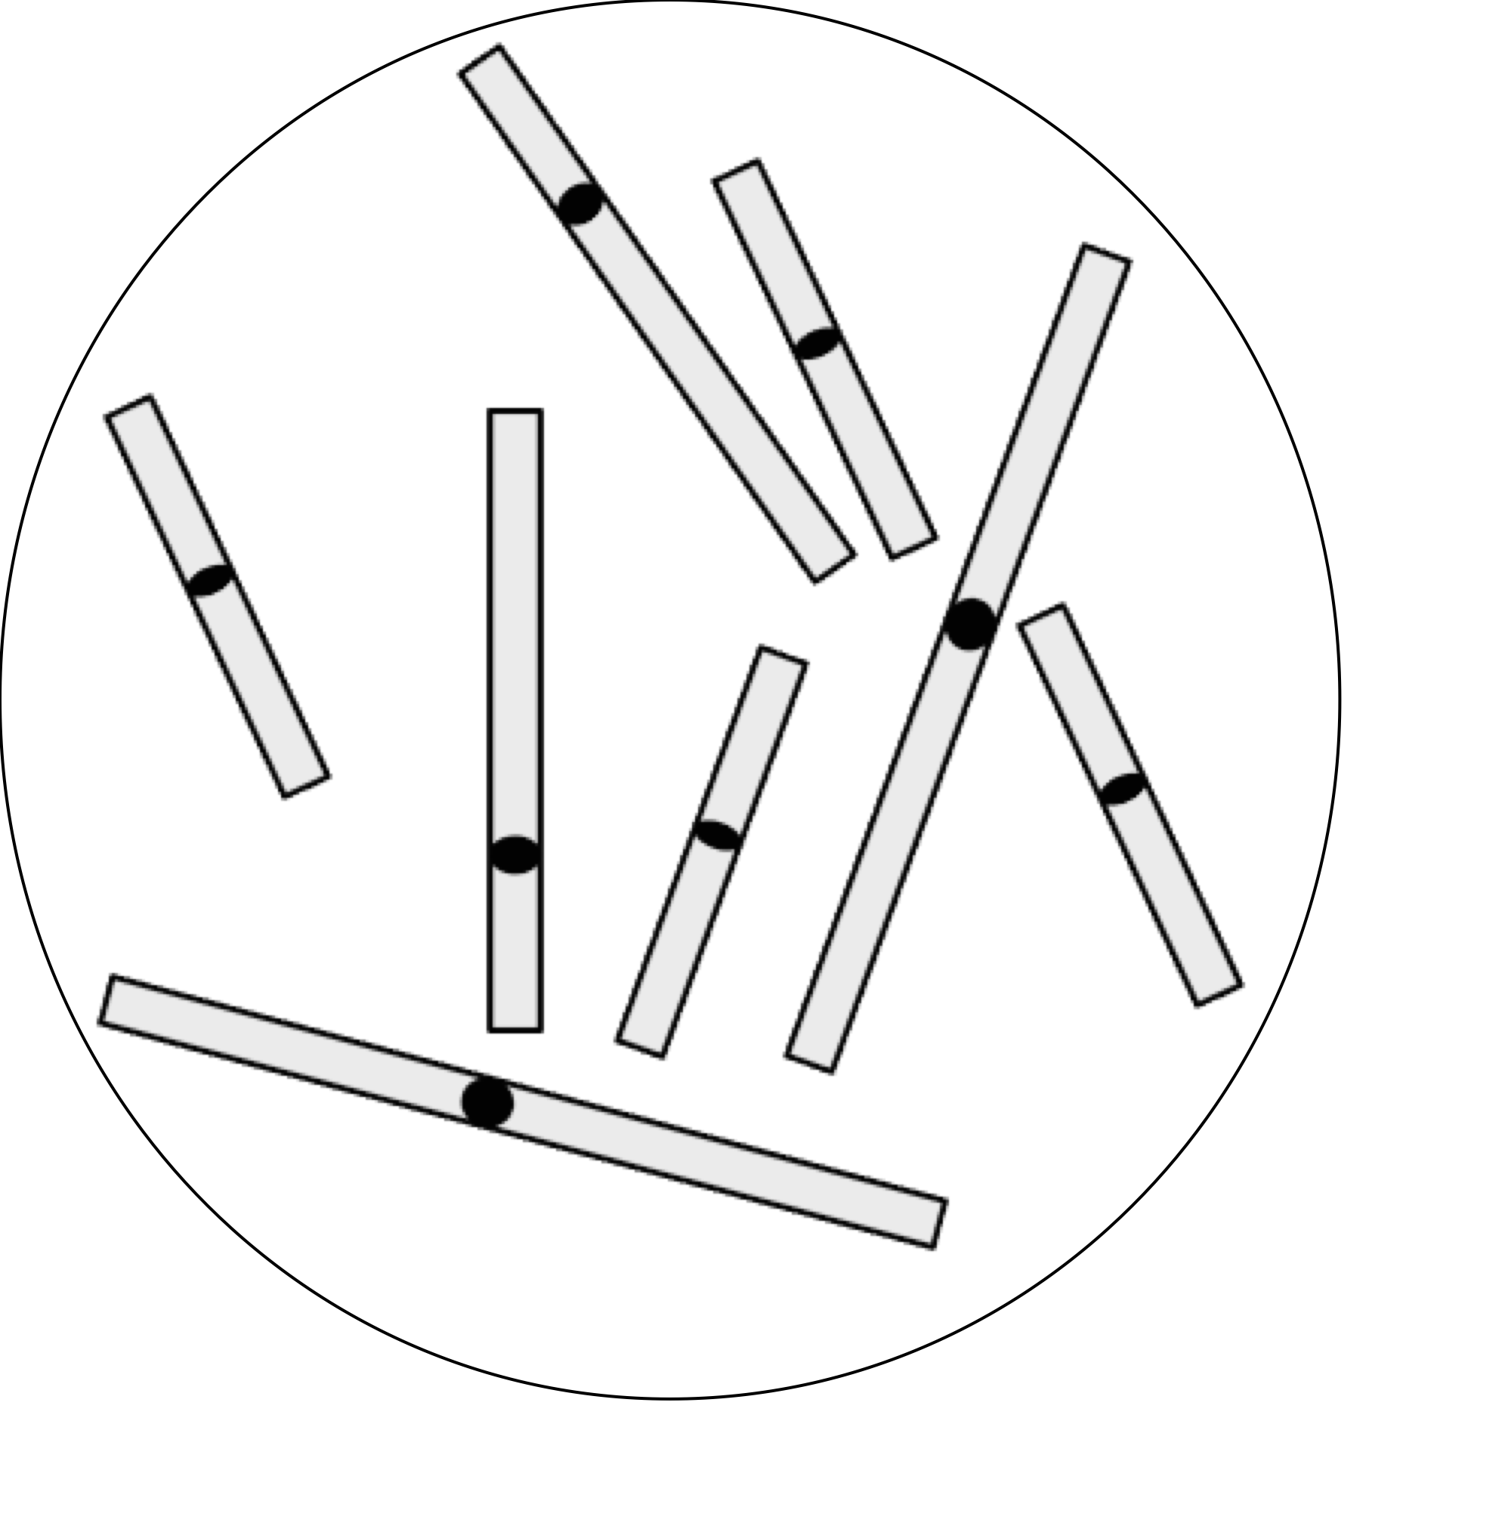
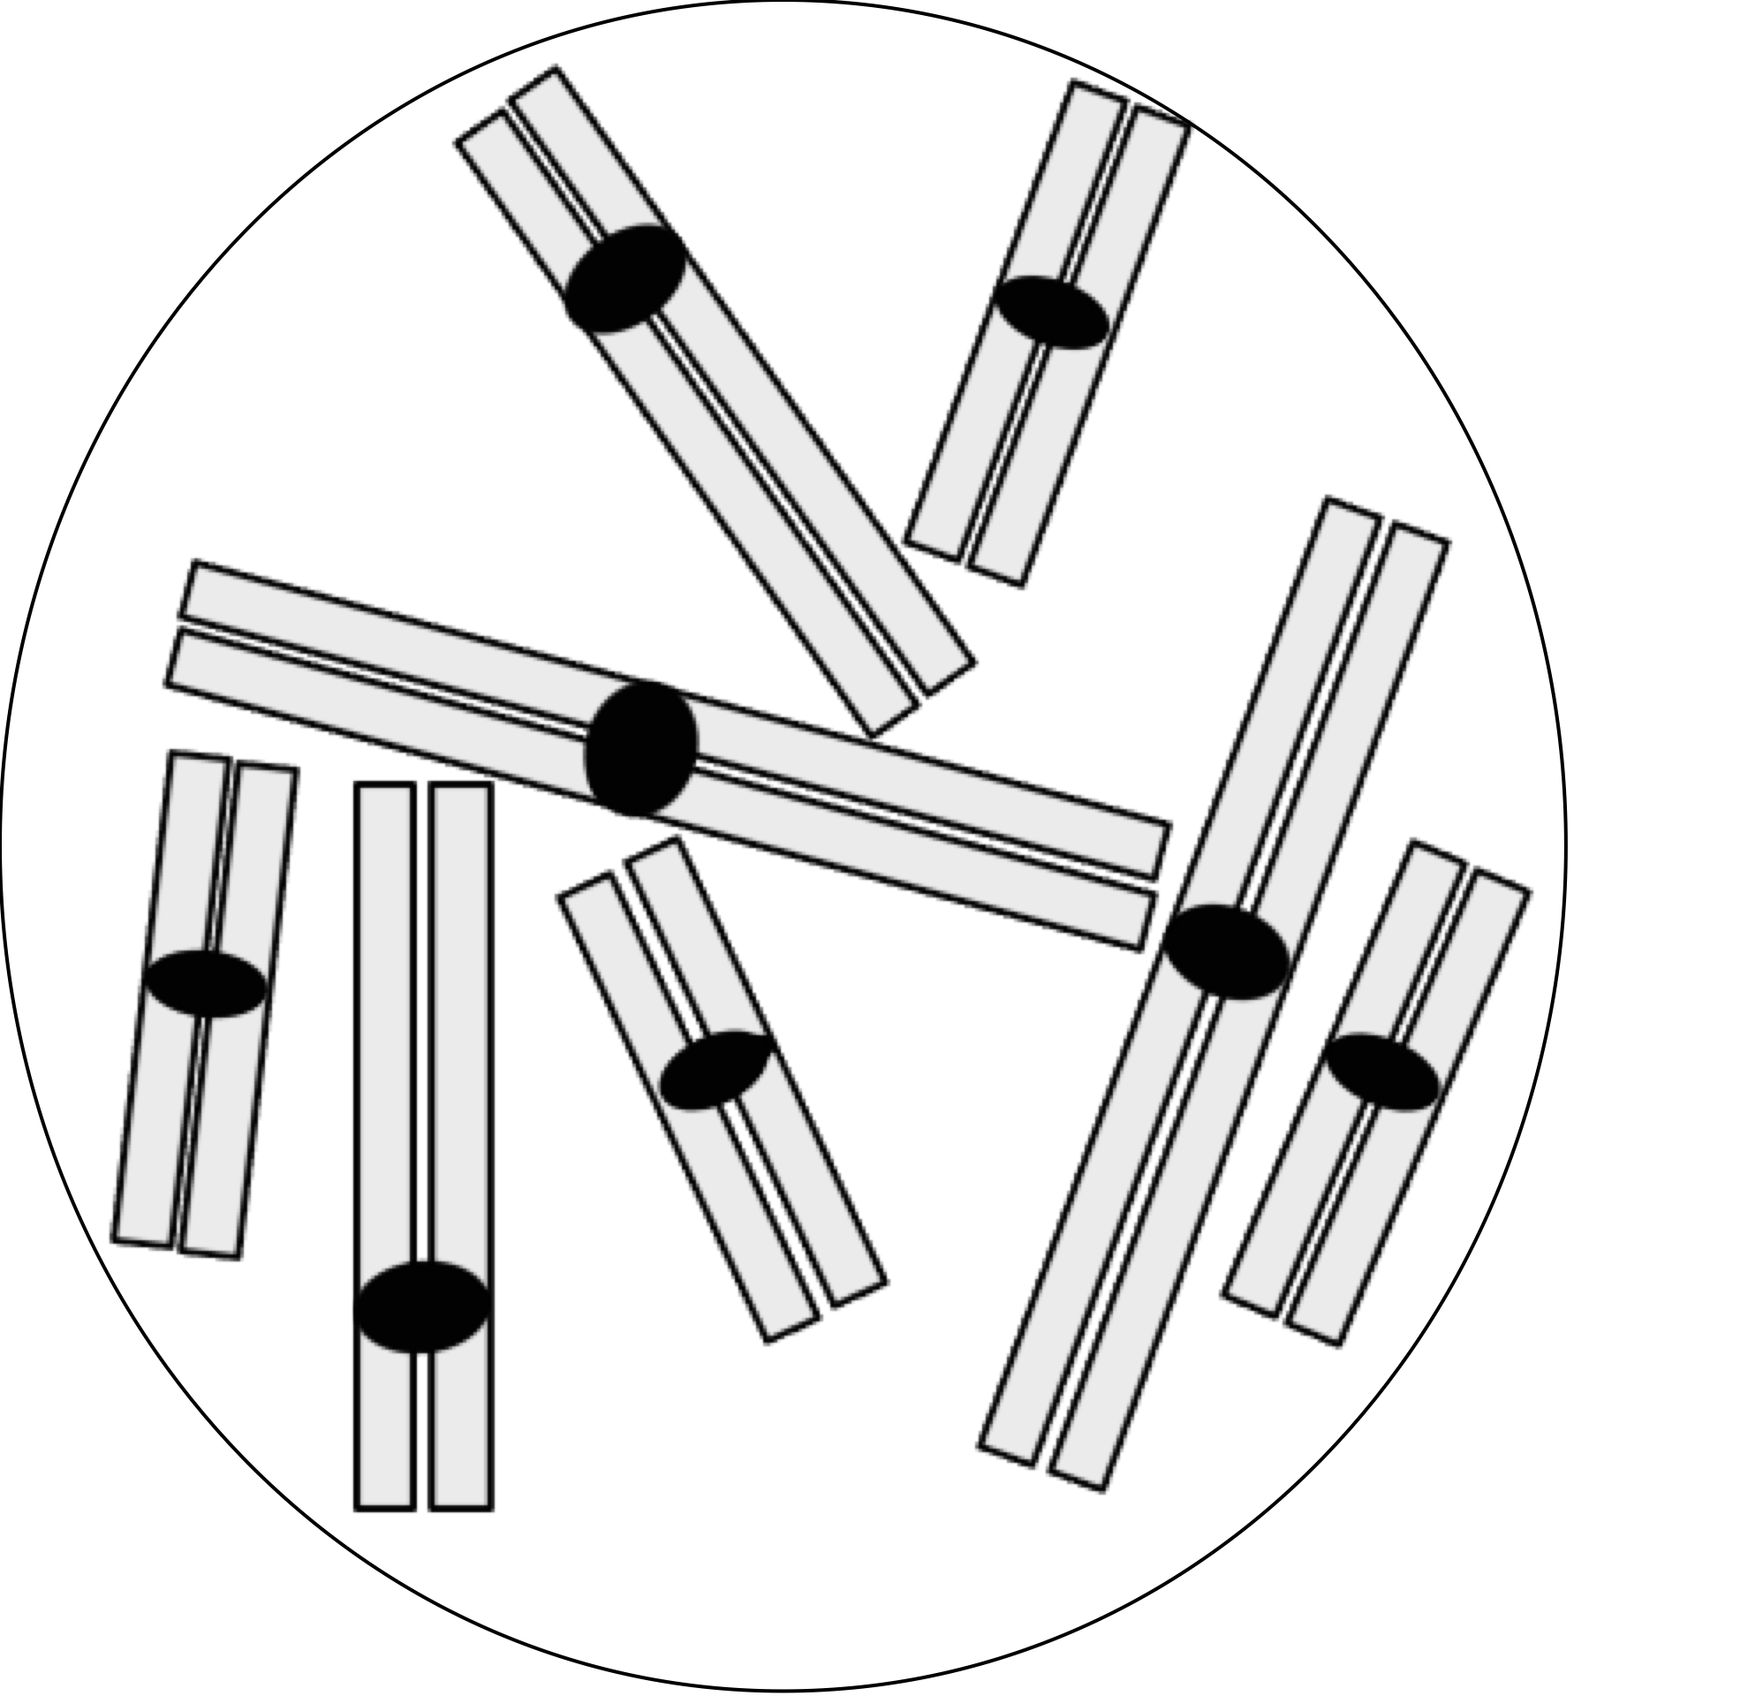
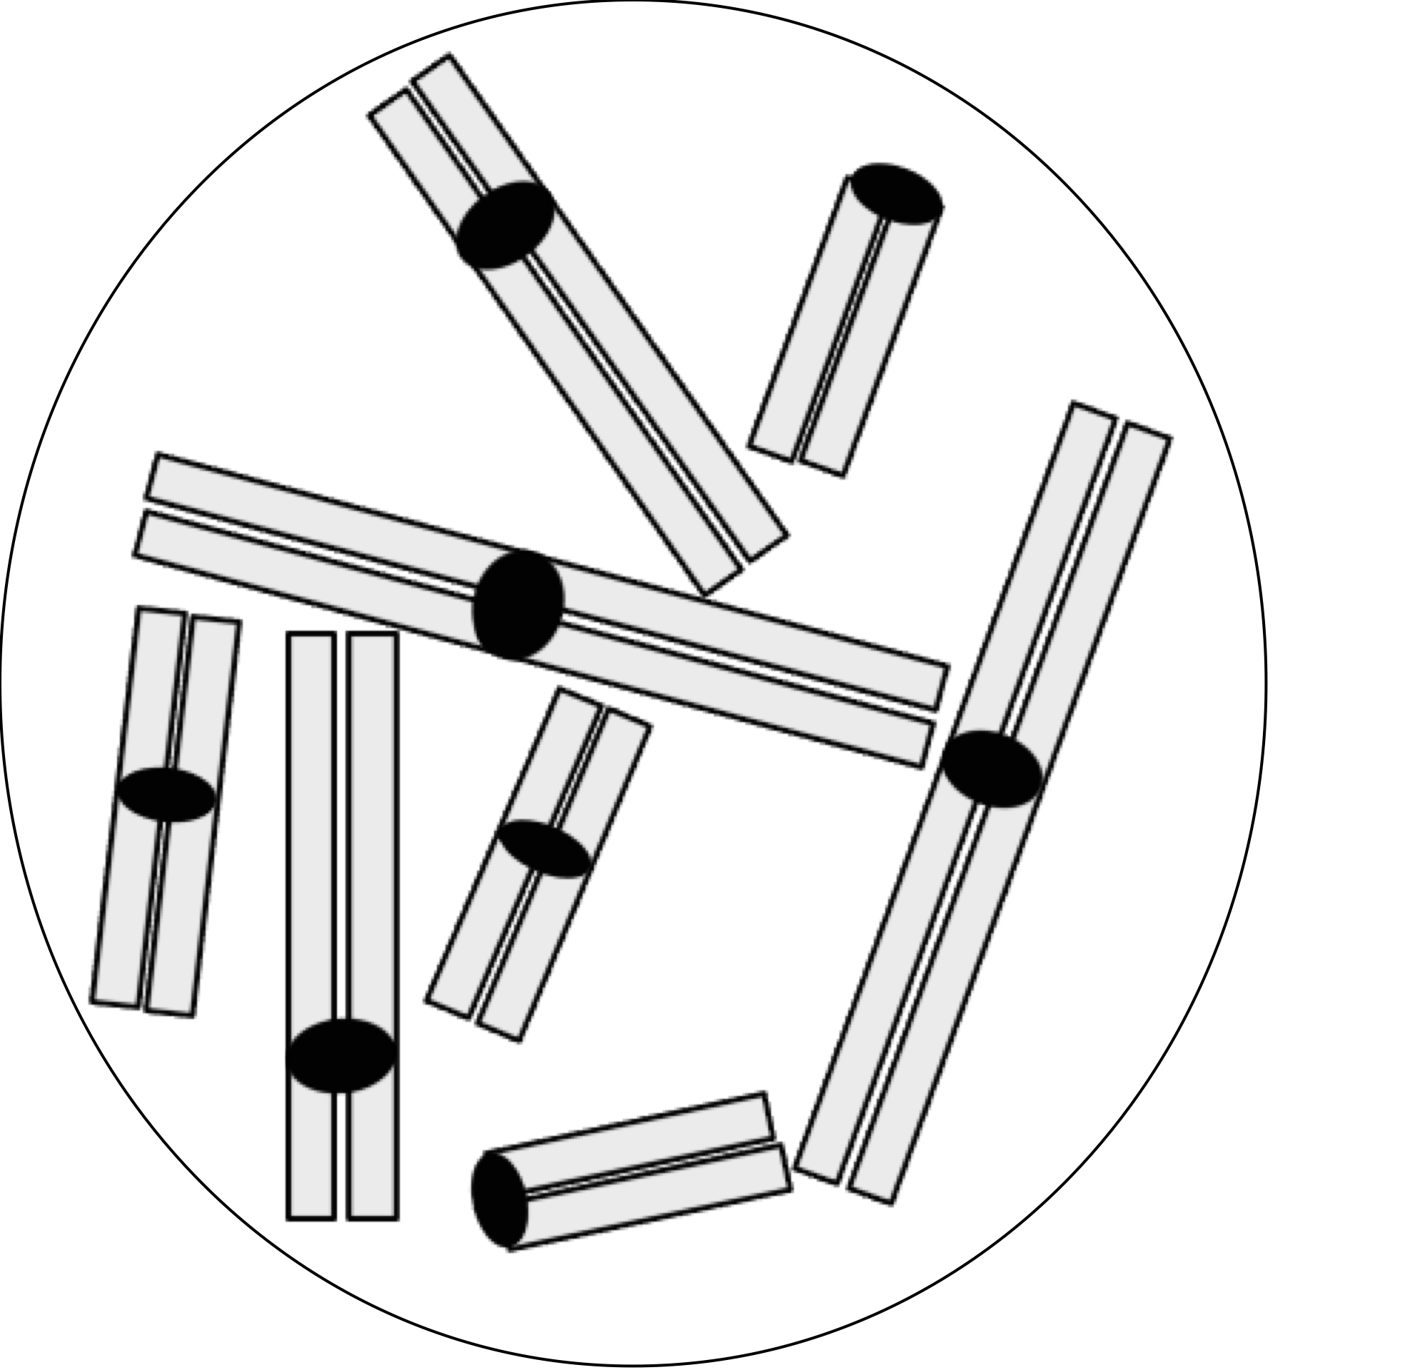
Question 11
SELECT ALL THE ANSWERS THAT APPLY
Which of the cells represented below contain a total of eight chromosomes?
a) b) c) d)

Slide 12
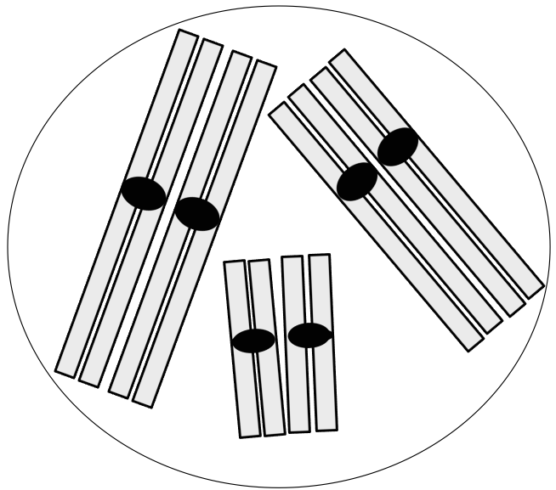
Question 12
SELECT THE SINGLE BEST ANSWER
What is the total number of chromosomes in the cell represented below?
a) 2.
b) 3.
c) 6.
d) 12.

Slide 13
Question 13
SELECT THE SINGLE BEST ANSWER
The amount of DNA in a woman’s skin cell prior to DNA replication is the same as the amount of DNA in one of her
germ cells at metaphase of meiosis I.
germ cells at prophase of meiosis I.
germ cells that have completed meiosis I, but have not yet started meiosis II.
mature gametes (germ cells that have completed meiosis II).

Slide 14
Question 14
SELECT ALL THE ANSWERS THAT APPLY
Which of the following events occur during prophase of meiosis I?
Crossing over of homologous chromosomes.
Lining up of homologous chromosomes in the centre of the cell.
Pairing of homologous chromosomes.
Replication of most of the chromosomal DNA (formation of sister chromatids).

Slide 15
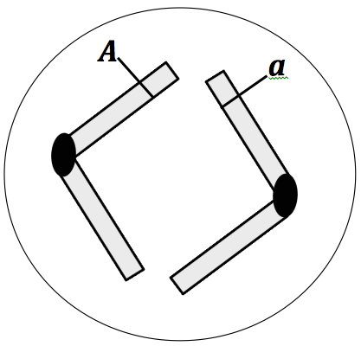
Question 15
SELECT THE SINGLE BEST ANSWER
The diagram below most likely represents the chromosomes of a cell at anaphase of:
An impossible situation
Meiosis I
Meiosis II
Mitosis

Slide 16
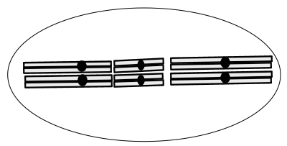
Question 16
SELECT THE SINGLE BEST ANSWER
The diagram below most likely represents the chromosomes of a cell at metaphase of:
Meiosis I
Meiosis II
Mitosis
Meiosis II or mitosis (impossible to tell which one)

Slide 17
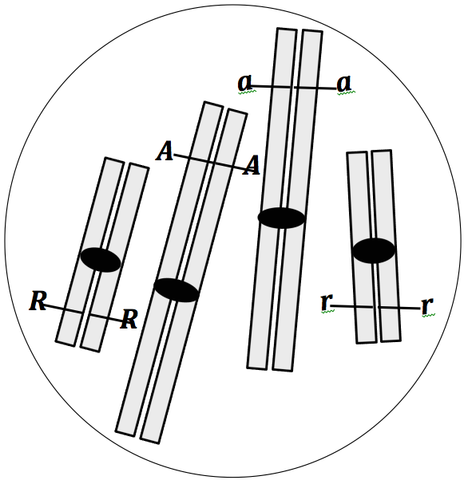
Question 17
SELECT ALL THE ANSWERS THAT APPLY
Several cells like the one represented on the right undergo a normal meiosis I and meiosis II, so that each cell produces four daughter cells. One or more of these daughter cells are shown below. Which one(s) could they/could it be?

